Slide 1

CONFIGURABLE NEUROMORPHIC PROCESSOR ARCHITECTURE FOR SPIKING NEURAL NETWORKS
R.M.T.N.K Rathnayaka (E/17/286)
Supervised by Dr. Isuru Nawinne
Department of Mechanical Engineering
Faculty of Engineering
University of Peradeniya
ME420- Mechanical Engineering Individual Research Project
End Evaluation
November, 2023

Slide 2

Content
Title
Introduction
Background
Methodology
Implementations
Experiments
Findings
Achievement of the Objectives
Potential Improvements

Slide 3
Introduction
01

Slide 4
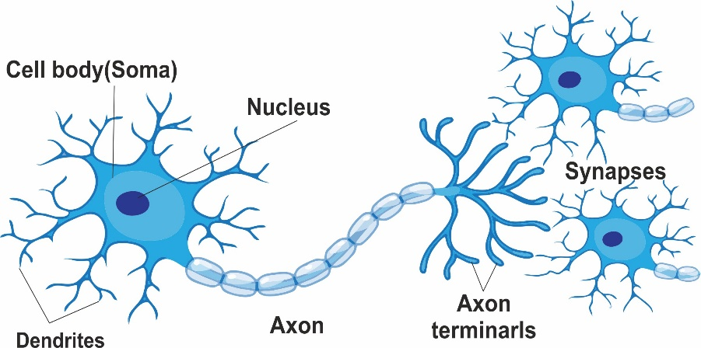
Introduction
What is a Neuron?
A neuron is a specialized cell in the brain that processes and transmits information through electrical and chemical signals, forming the basis of all cognitive functions

Slide 5


Introduction
What is a Neural Netwok?
Complex interconnected system of neurons in the nervous system of animals, including the human brain, that work together to process and transmit information through electrical and chemical signals

Slide 6


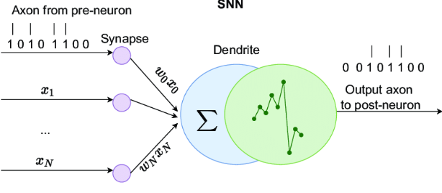
Introduction
What is a Artificial Neuron?
An artificial neuron mimics the behavior of biological neurons, processing inputs through weights and biases to produce an output, forming the building block of neural networks.

Slide 7
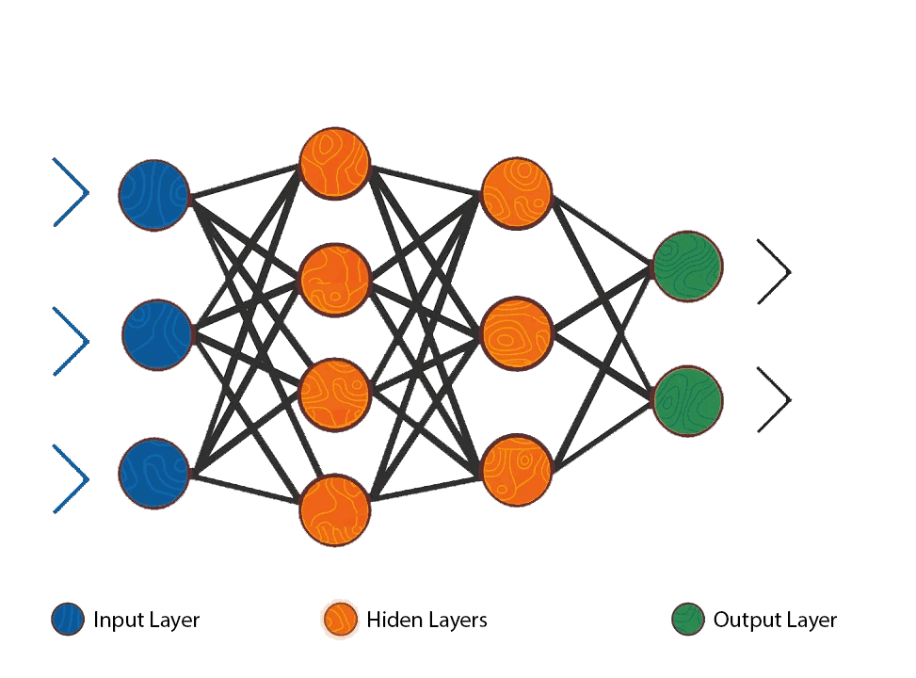
Introduction
What is a Artificial Neural Network?
Computational model composed of interconnected artificial neurons, designed to learn and perform tasks by adjusting weights through training, inspired by the structure and function of biological neural networks

Slide 8
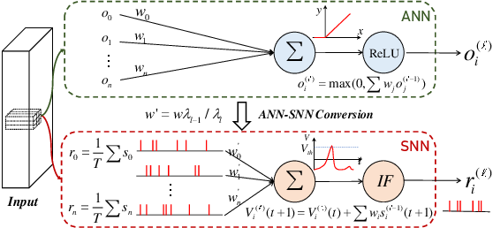
Introduction
What is a Spiking Neuron
A computational model that simulates the behavior of biological neurons more closely by considering the timing and frequency of individual spikes

Slide 9
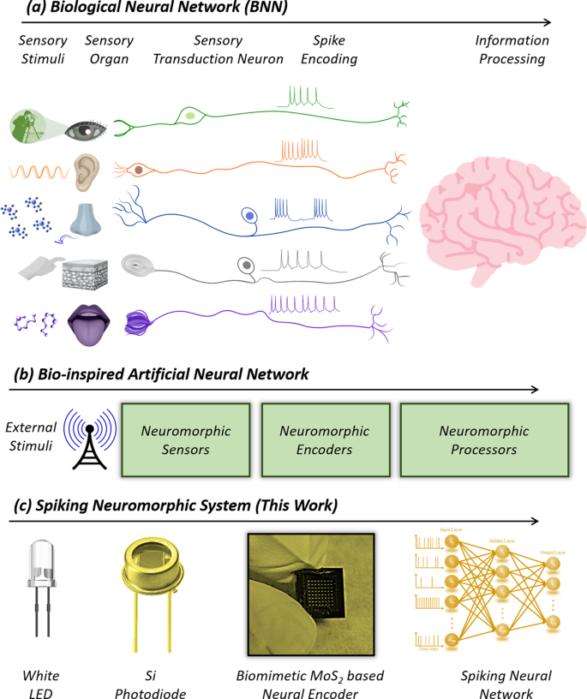
Introduction
What is a Spiking Neuron

Slide 10

Introduction
Spiking Neuron networks
Spiking neural networks introduce a more biologically accurate approach by modeling the timing of neuron spikes, potentially enhancing temporal information processing compared to traditional artificial neural networks,

Slide 11
Introduction
What is Spiking Neural Networks?
Spiking neural networks (SNNs) are a type of neural network that simulate the behavior of biological neurons and synapses.
The significance of SNNs lies in their ability to mimic the behavior of biological neural networks and in their potential for improving machine learning and artificial intelligence.
The basic components of an SNN include neurons, synapses, and input/output spikes.

Slide 12
Introduction
The Problem with SNN
SNNs have a larger computational cost
Memory bottlenecks
Difficult to achieve parallelism
Idle power consumption
There is a growing need for specialised architectures purpose-built for SNNs that are scalable and configurable
12

Slide 13
Introduction
What is Neuromorphic Engineering?
Neuromorphic computing is an approach to computing that uses hardware and software inspired by the principles of the human brain.
The goal of neuromorphic computing is to develop computers that can perform complex tasks with energy efficiency and robustness similar to that of biological neural networks.
Compared to traditional architecture, neuromorphic computing offers potential advantages such as lower power consumption, faster processing, and more efficient use of memory
13

Slide 14

Introduction- Aim
The aim of our research is to develop a configurable neuromorphic processor architecture for spiking neural networks that uses the RISC-V instruction set architecture, and to demonstrate that architecture is both high-performing and low-power, making it an attractive solution for a range of applications.

Slide 15
Introduction -Objectives
To complete the current RISC-v NOC (Network on Chip) FPGA implementation for SNNs and integrate it into the processor architecture.
.
3
To implement a RV32IM pipelined CPU in Verilog as a starting point for the design.
.
To create a test SNN application to verify the functionality and performance of the processor architecture.
.
2
4
1
1
2
To design and implement a Configurable neuromorphic processor architecture for spiking neural networks.
To evaluate the power consumption and speed of the configurable neuromorphic processor architecture and compare it with existing solutions in the literature
1
GO
5

Slide 16
Background
02

Slide 17

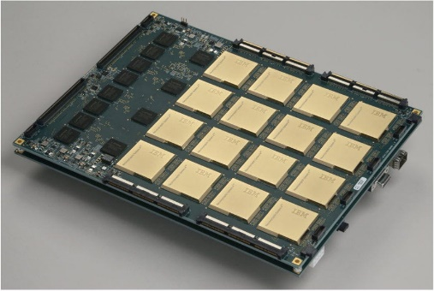
Background
Existing Architectures
General-purpose
Application-specific
17
17

Slide 18
Background
Existing Architectures
High Overhead
General-purpose
SpiNNaker
(APT Research Group, Department of Computer Science, University of Manchester)
DYNAP
(Moradi, S. et al.)
18

Slide 19
Background
Existing Architectures
OpenSpike
(Modaresi, F. et al.)
Zhang, J. et al.
Low Flexibility
Application-specific
19

Slide 20
Background
Our Contribution
High Overhead
General-purpose
Our Design
Low Flexibility
Application-specific
20

Slide 21
Methodology
03

Slide 22
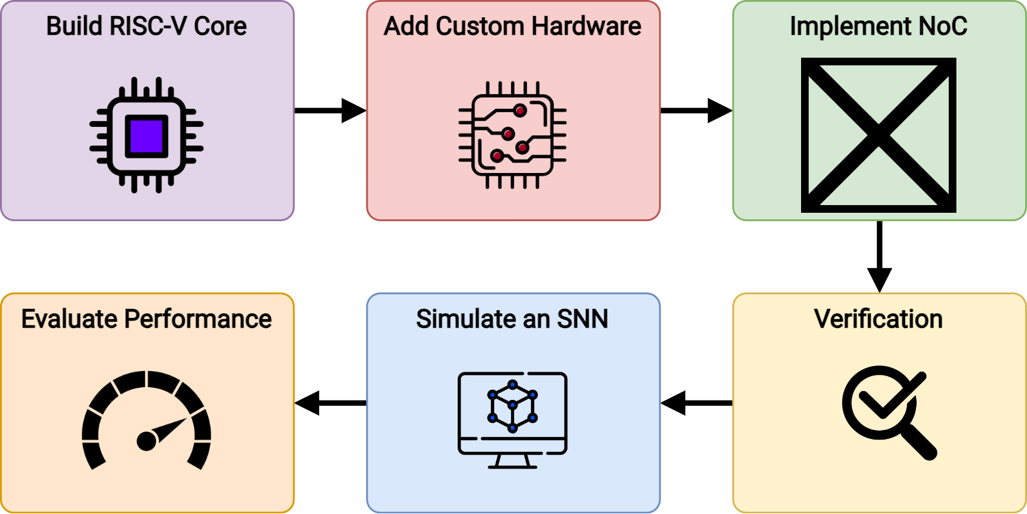
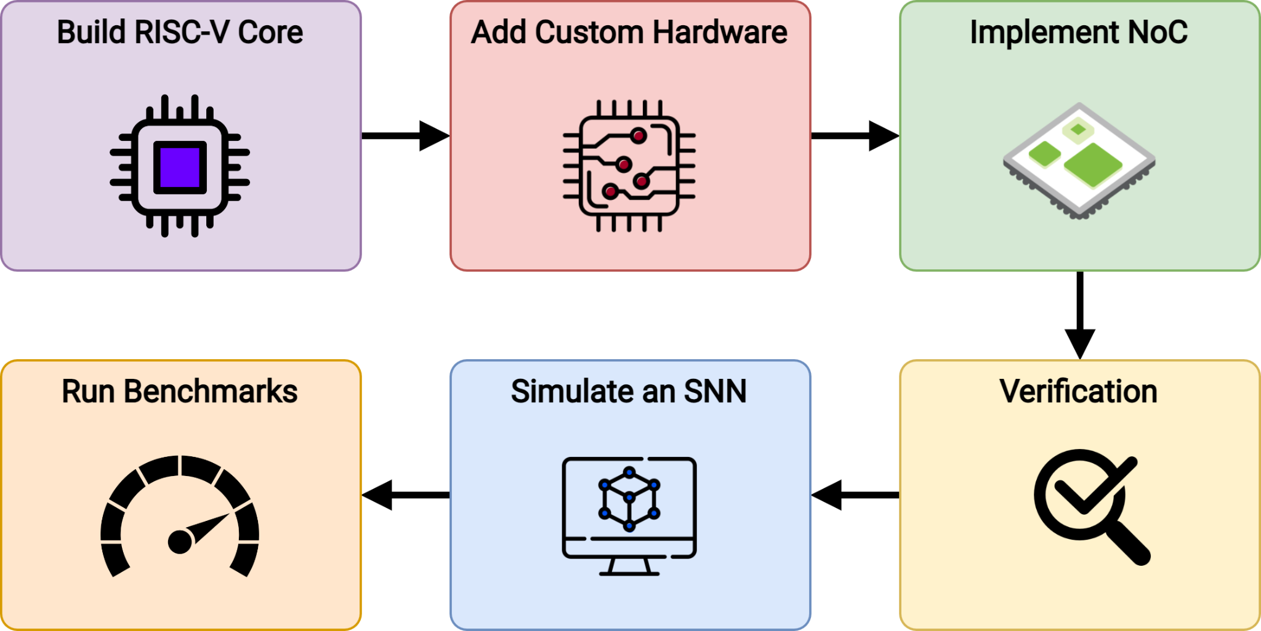
Methodology

Slide 23
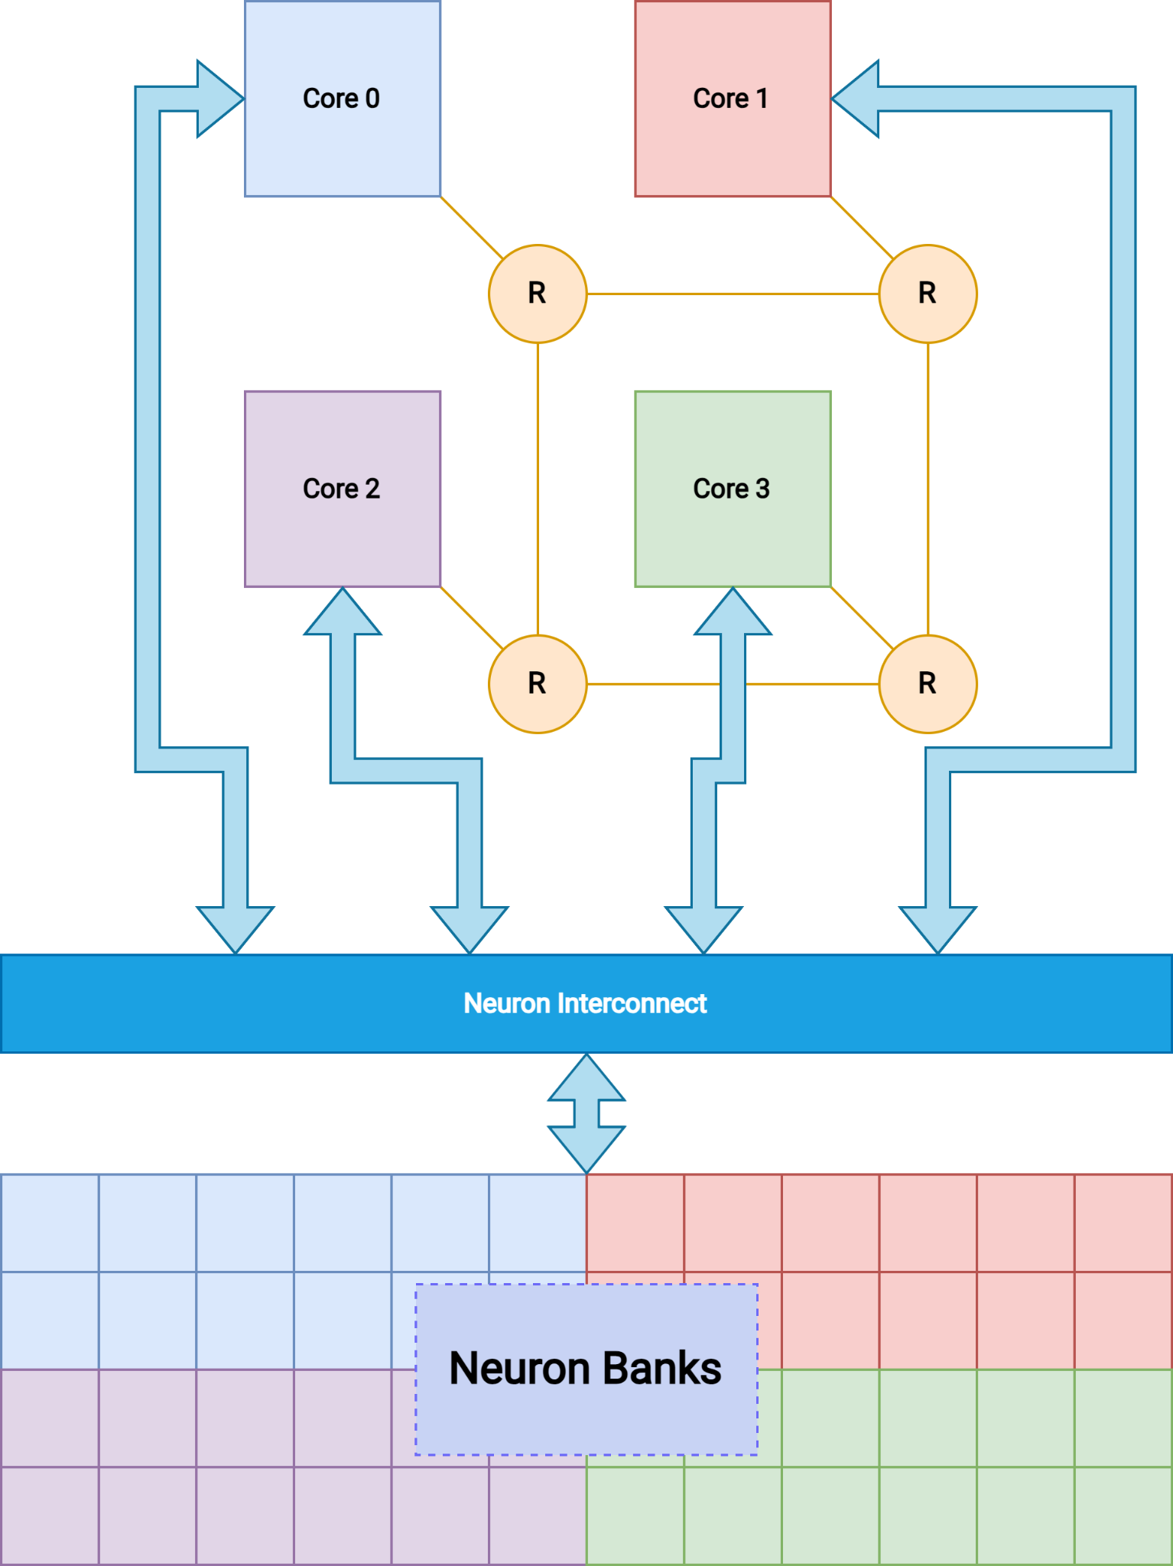
Methodology
Overall Architecture
Neuron Configuration
NoC
Spike Resolution
Neuron State Update
Neuron Banks
After-Spike Reset
23

Slide 24
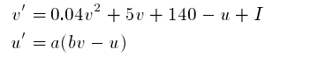


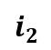
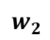
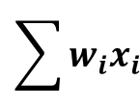


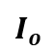
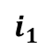
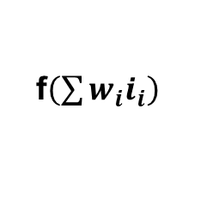
Methodology
How it works
$$i_{1}$$
$$w_{1}$$
$$\sum{w_{i}x_{i}}$$
I
$$I_{o}$$
$$w_{2}$$
f$\left(\sum{w_{i}i_{i}}\right)$
$$i_{2}$$
$$w_{i}$$
$$i_{i}$$

Slide 25
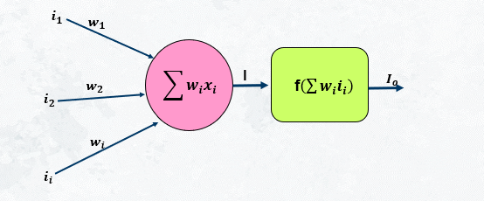
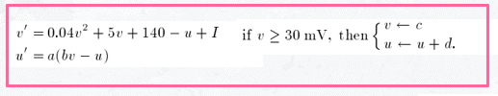
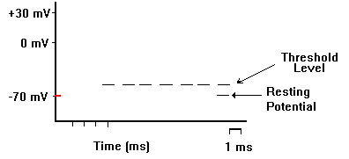
Methodology
How it works
If(V>30mV) -> Spike

Slide 26
Methodology
How it works
Weights calculations
Neuron configurations
Spike resolution
Overall Controlling the hardware
NoC
Neuron Banks
26

Slide 27
Implemetations
03

Slide 28
Implementation
Neuron Configuration
NoC
Spike Resolution
Neuron State Update
Neuron Banks
After-Spike Reset
28

Slide 29
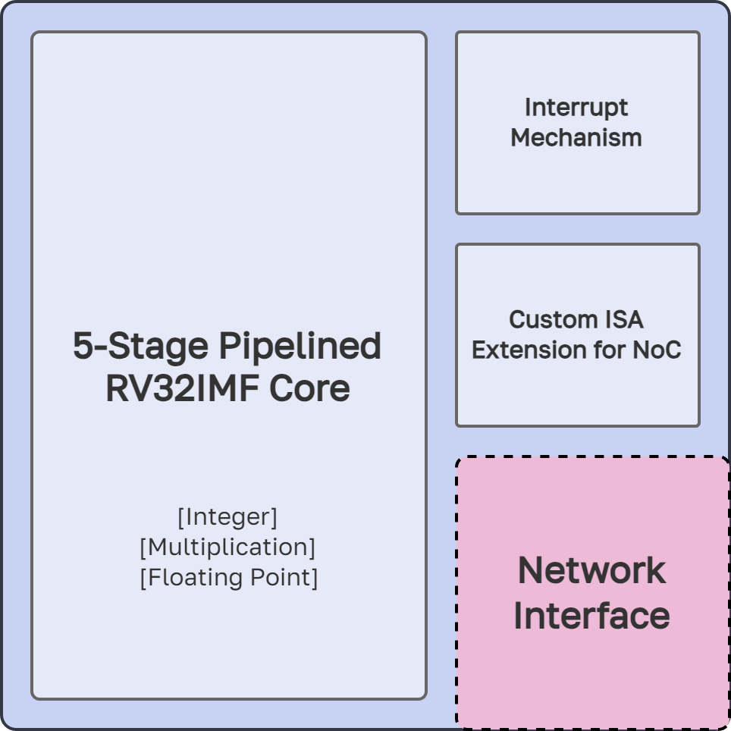
Implementation

Slide 30
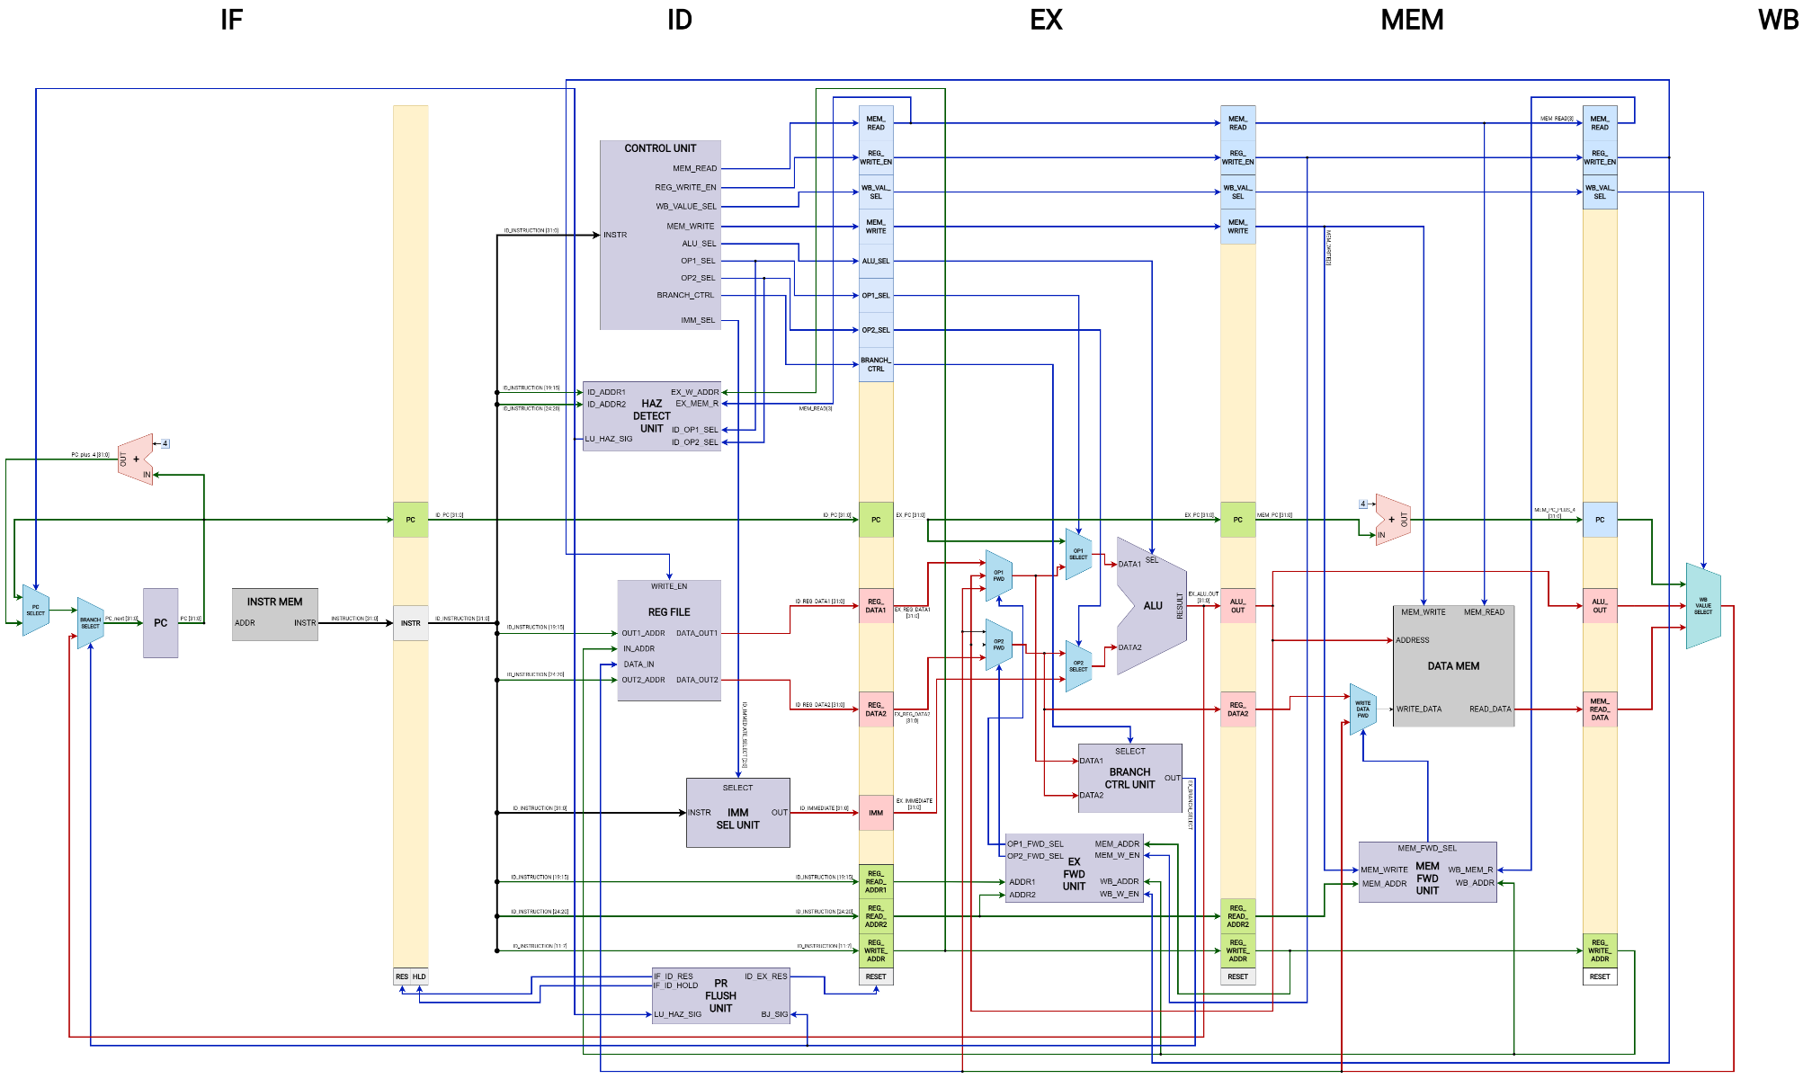
Implementation

Slide 31
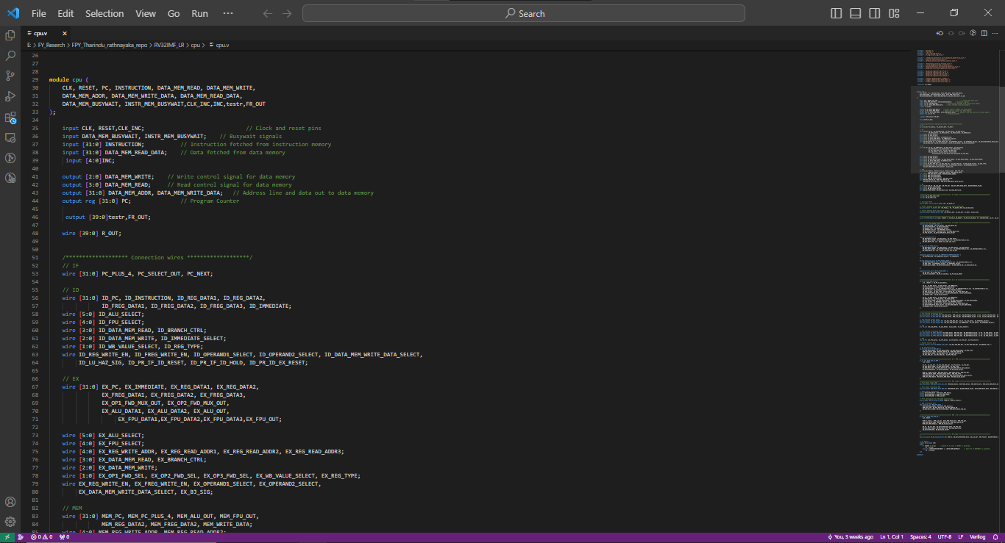
Implementation

Slide 32
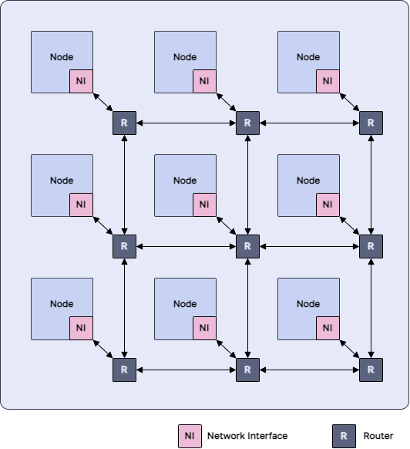
Implementation
The NoC
Customised RISC-V Core
Router
FIFO Network Interface
Network-on-Chip
32

Slide 33
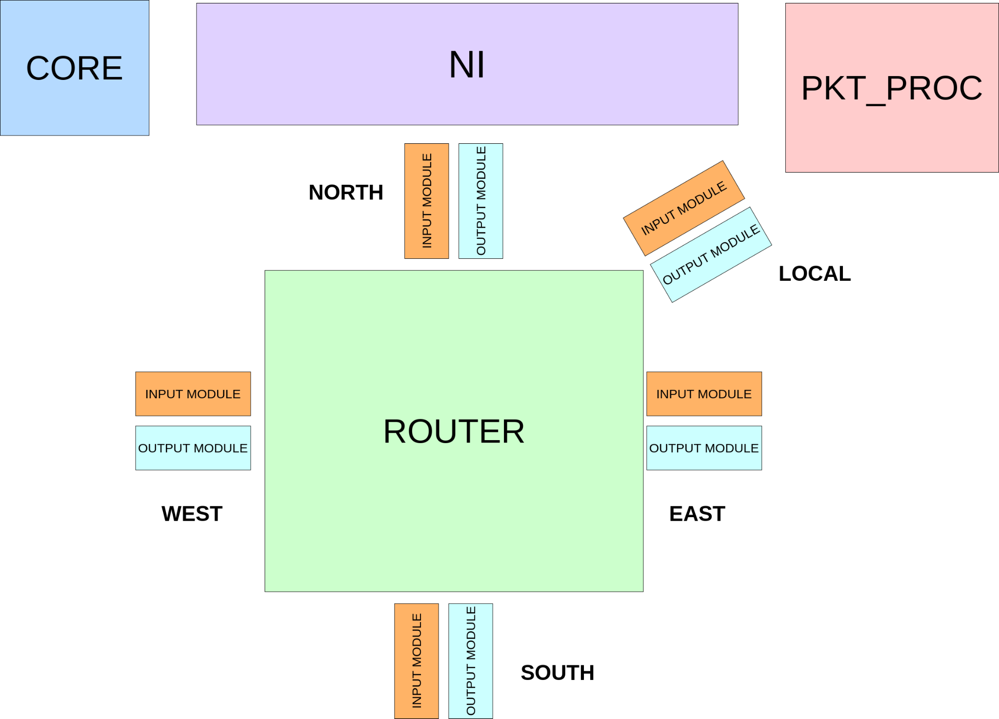
Implementation
The NoC
33

Slide 34
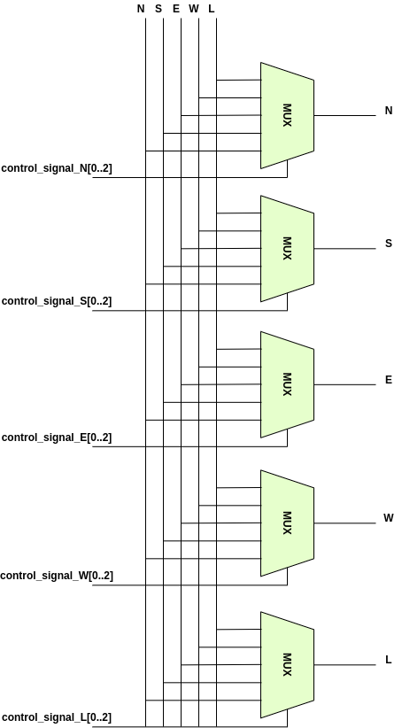
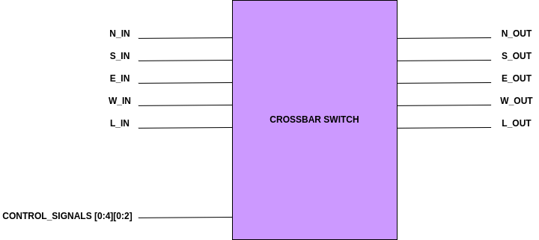
Implementation
Router
34
34

Slide 35
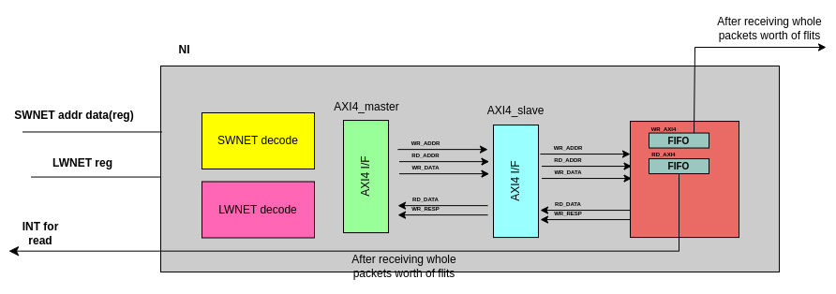
Implementation
Network Interface
35
35

Slide 36
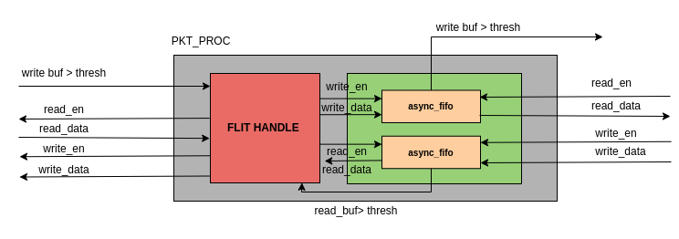
Implementation
PKT_PROC
36
36

Slide 37
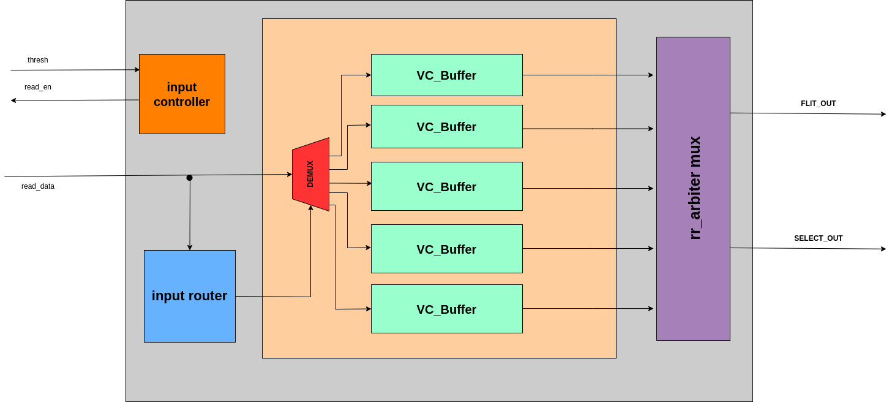
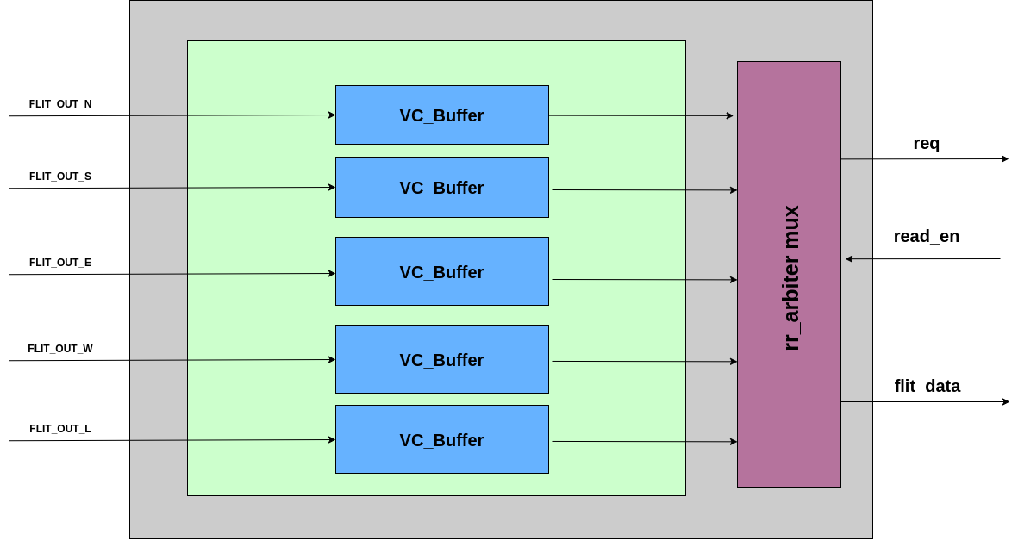
Implementation
INPUT / OUTPUT MODULES
37
37

Slide 38
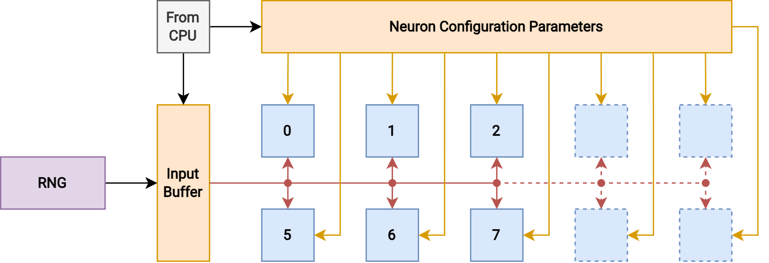
Implementation
Neuron Banks
38
38

Slide 39
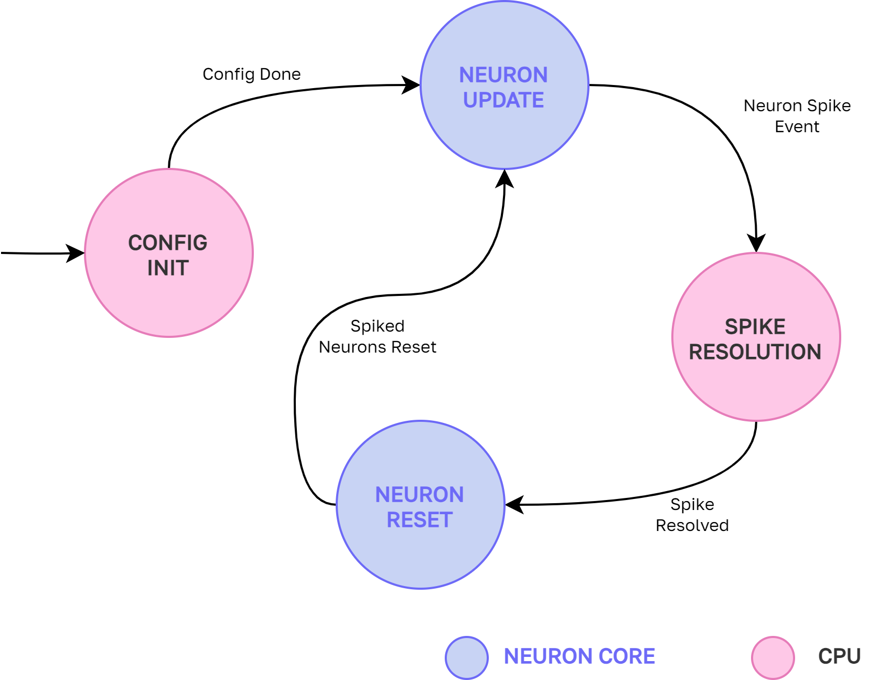
Implementation
Final Architecture
39
39
39

Slide 40
Verification
02

Slide 41
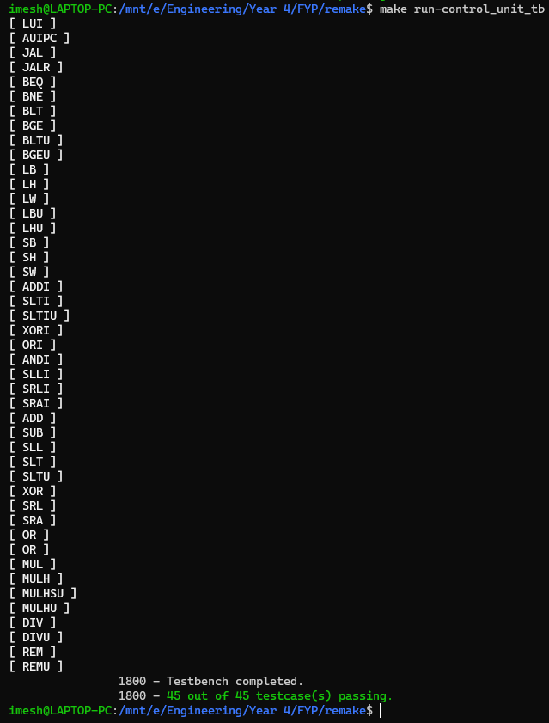
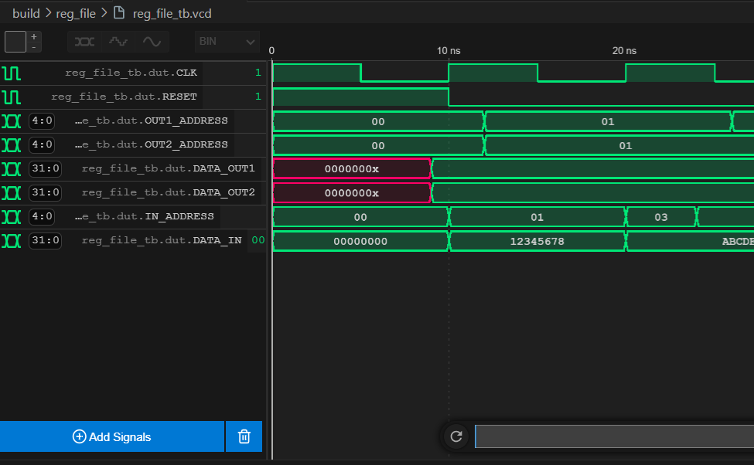
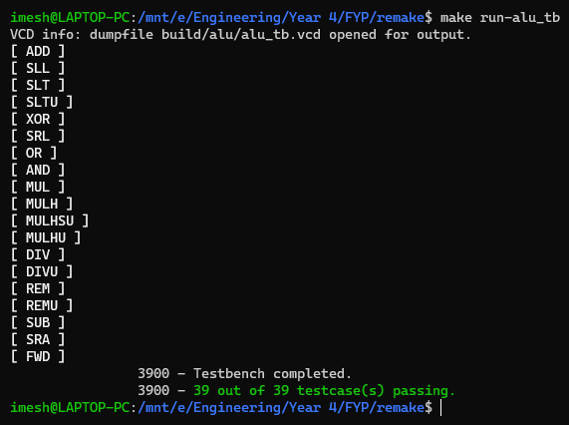
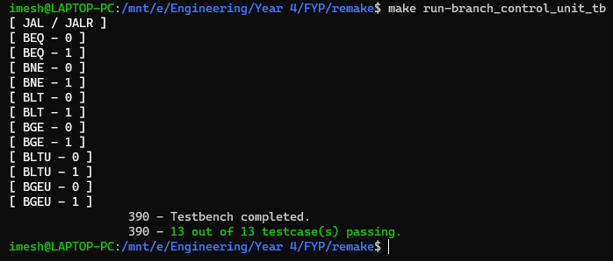
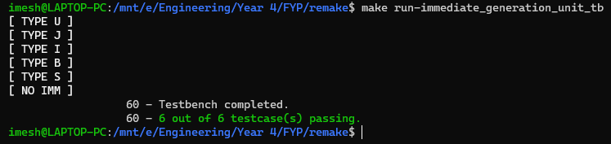
Verification
Verification - Software Simulations
41

Slide 42
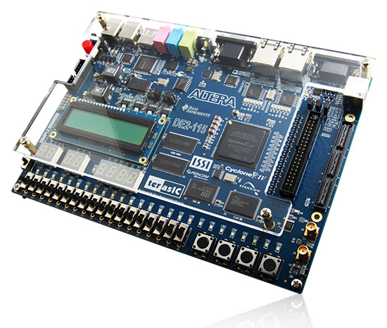
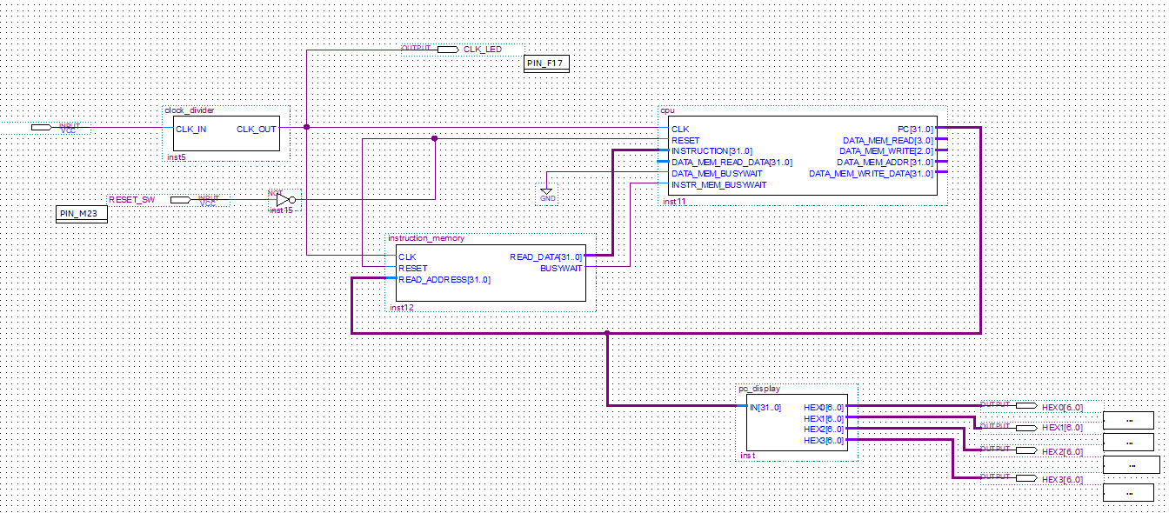
Verification - Hardware Testing
Verification
42

Slide 43
Experiments
02

Slide 44
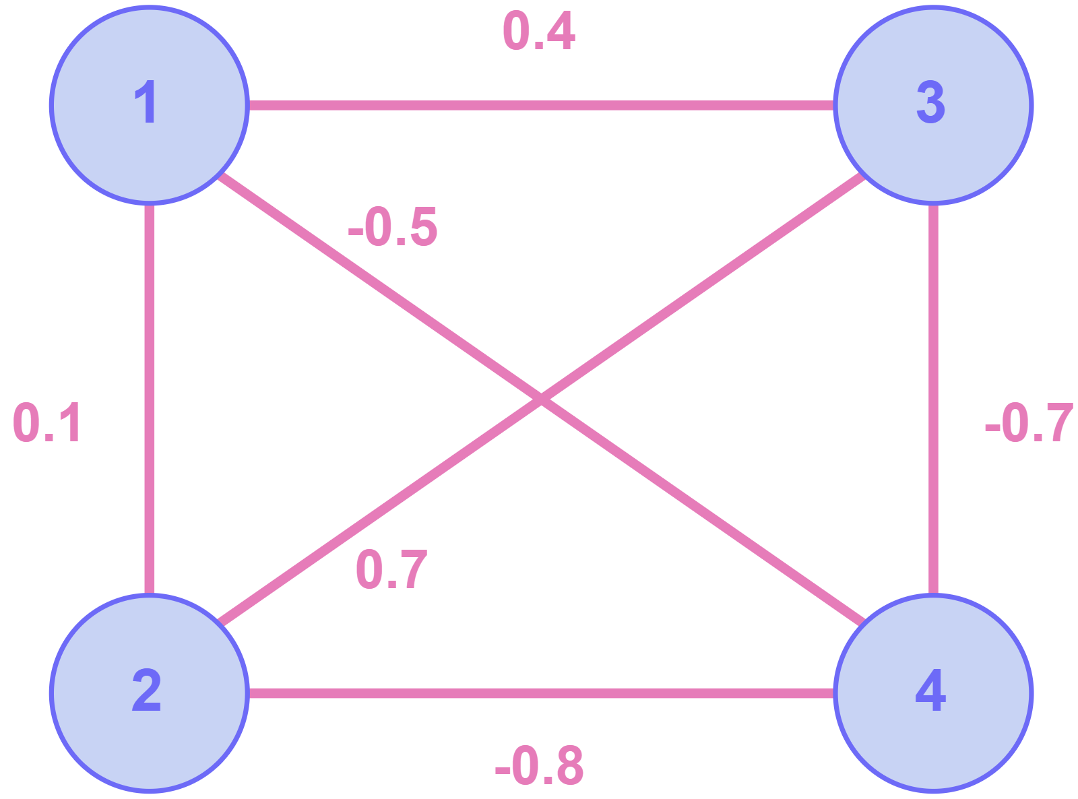
Experiments
Setup
Sample SNN with four neurons
Simulated on FPGA hardware
Three different configurations
Single RISC-V Core
Two-Core NoC
Two-Core NoC + Neuron Banks
Measured clock cycles taken to execute 1s of the simulation (1ms timesteps)
44

Slide 45
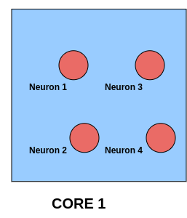
Experiments
Experiment I: Single Core
45

Slide 46
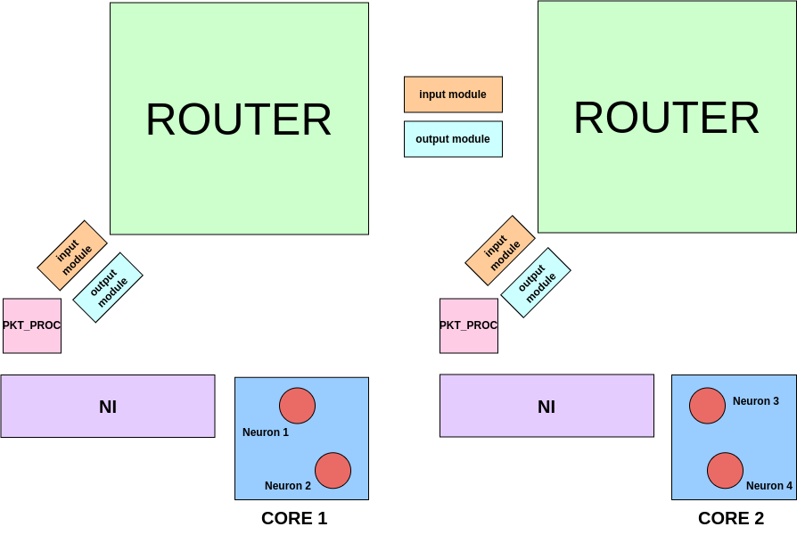
Experiments
Experiment II: 2-Core NoC
46

Slide 47
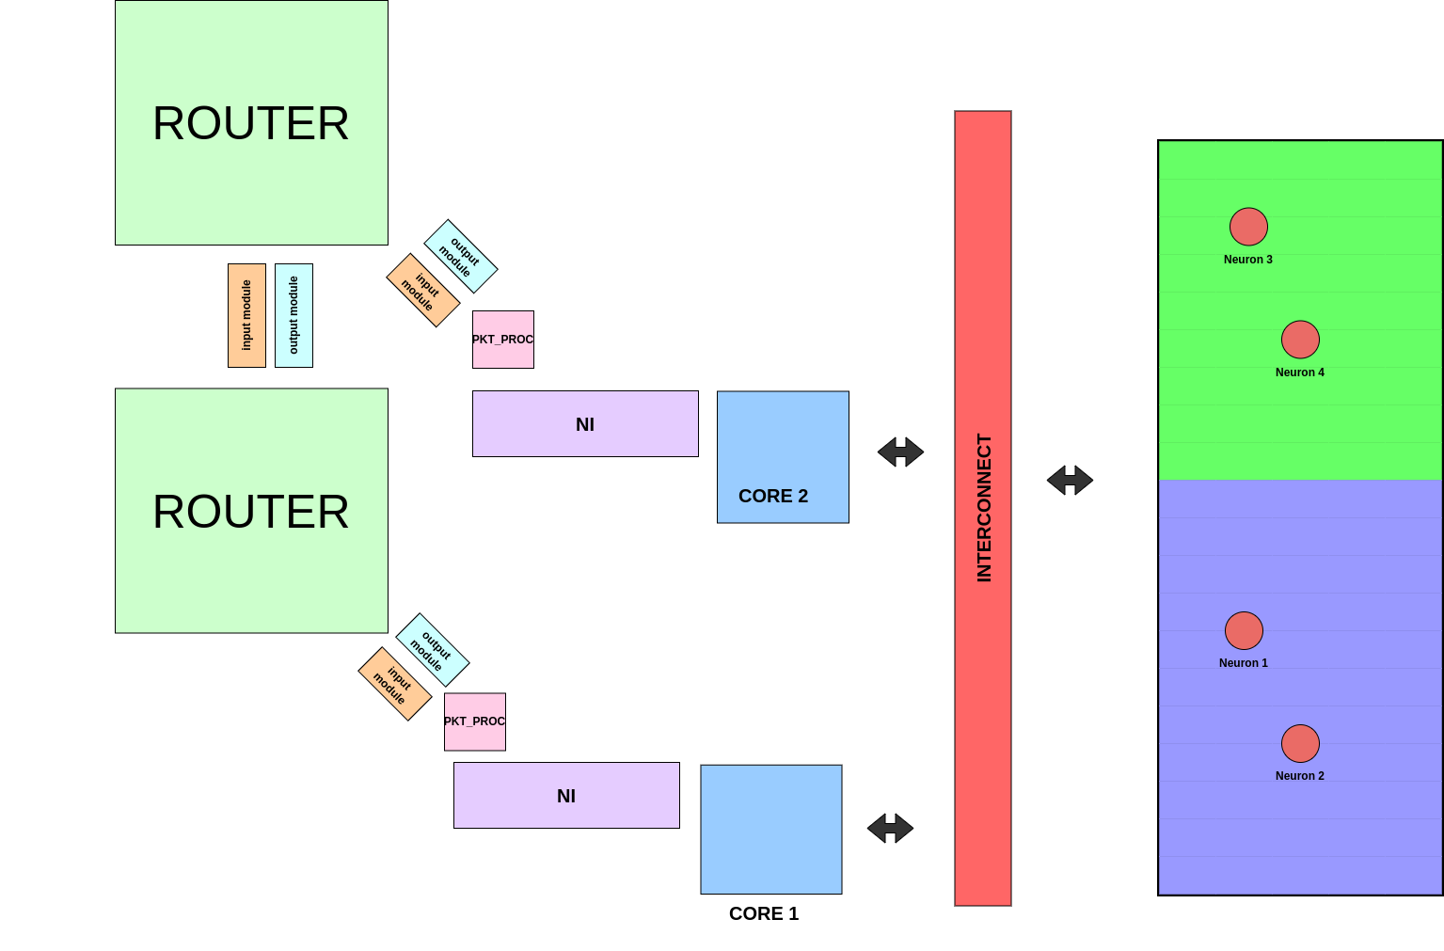
Experiments
Experiment III: 2-Core NoC + Neuron Banks
47

Slide 48
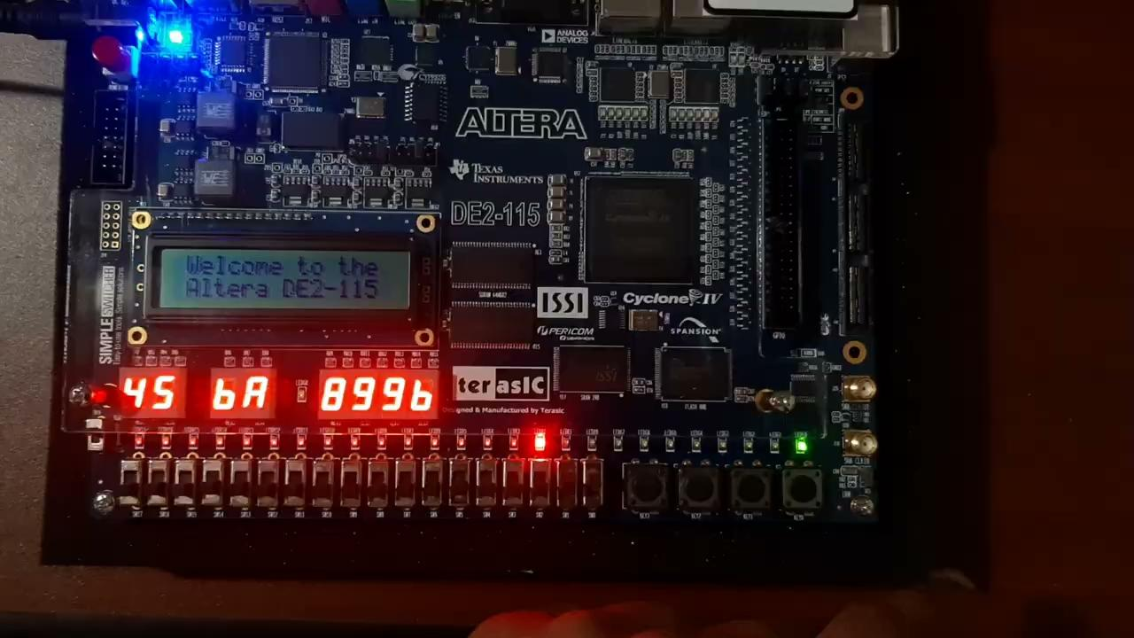
Experiments

Slide 49
05
FINDINGS
49

Slide 50
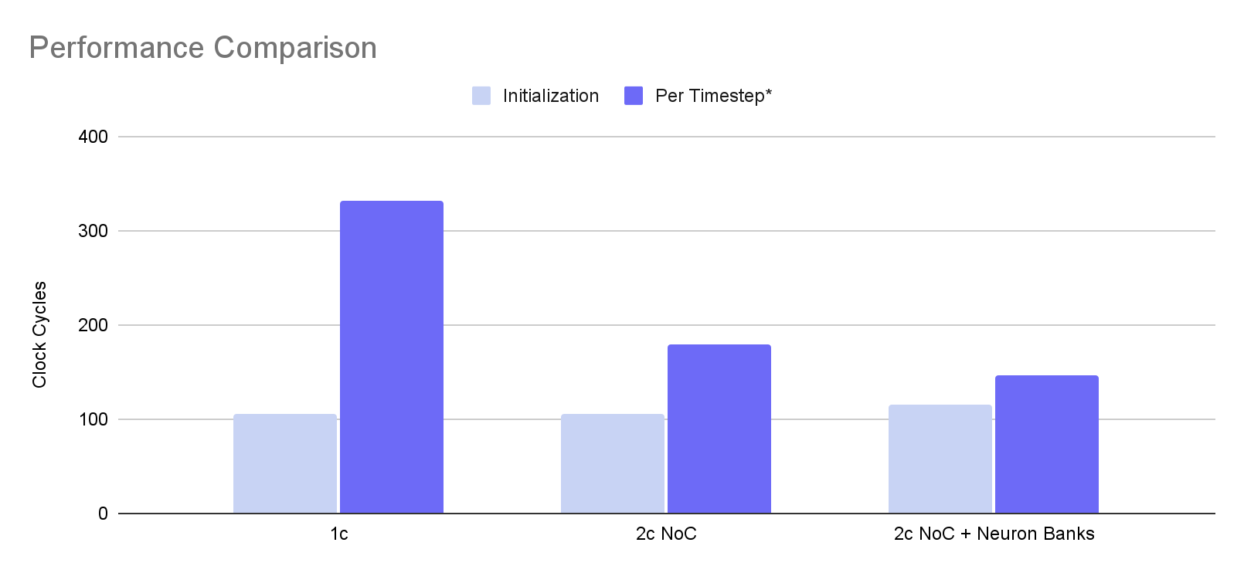
Findings
Results
[*] No. of clock cycles for a 1ms timestep of the SNN simulation
50

Slide 51
Findings
Scalability
In the 2C NoC scenario, scalability is limited by register space in the CPU
Scalability is improved by offloading the work to specialised neuron cores
Added initialization latency becomes negligible at scale
51

Slide 52
06
Achievement of
Project Objectives
52

Slide 53

Achievements of objectives
Project Objectives
SNN simulation on the custom design
Synthesizable custom RISC-V CPU + NoC
Testing the performance
53

Slide 54
Potential Improvements
Potential Improvements
Out-of-order execution on the RISC-V core
Spike resolution algorithm improvements
Programming abstractions
54

Slide 55
Thank You!
Any questions?

